Slide 1
Chapter 12 Biotechnology and It’s Application

Slide 2
Biotechnology and its application –an Introduction
Biotechnology deals with industrial scale production of biopharmaceuticals and biological products using genetically modified microbes, fungi, plants and animals.
The applications of biotechnology include
diagnostics,
therapeutics,
Genetically Modified Organism (GMO*) = GMA, GMP, GMF, GMB
genetically modified crops for agriculture,
processed food,
Bioremediation (waste management technique by using organisms to remove or neutralize pollutants from a polluted site),
waste treatment, and
energy production.
* Bacteria, fungi and animals whose genes have been altered by manipulation
Notes:
In RNA, every nucleotide residue has an additional –OH group present at 2' -position in the ribose.
Also, in RNA the uracil is found at the place of thymine (5-methyl uracil, another chemical name for thymine).

Slide 3
Three critical research areas of biotechnology
Providing the best catalyst
(either in the form of improved microbes or pure enzyme)
Three critical research areas of biotechnology
Downstream processing technologies
to purify protein/organic compound
Creating optimal conditions
for catalyst to act

Slide 4
Green Revolution enhanced production of food
The Green Revolution succeeded in tripling the food supply
Increased yields during green revolution was
partly due to the use of improved crop varieties,
mainly due to the use of better management practices and
use of agrochemicals (fertilisers and pesticides).
Green Revolution was not enough
to feed
the growing human population.

Slide 5
Three agricultural options for increasing/enhancing food production
Agro-chemical based agriculture
Three agricultural options
Genetically engineered crop based agriculture.
Organic agriculture

Slide 6
Uses and significance of GM Plants
GM plants have been useful in many ways and are significant in the following ways;
to make crops more tolerant to abiotic stresses (cold, drought, salt, heat).
to reduce reliance on chemical pesticides (pest-resistant crops).
to reduce post harvest losses.
to increase efficiency of mineral usage by plants (this prevents early exhaustion of fertility of soil).
to enhance nutritional value of food. For example Vitamin ‘A’ enriched rice.
to create tailor-made* plants to supply alternative resources to industries, in the form of starches, fuels and pharmaceuticals.
*made specially to a particular purpose

Slide 7
Read about Bt cotton in page number 208 of NCERT Text book

Slide 8
Pre test Bt toxin
What is Bt toxin?
Answer: Bt toxin is an proteinaceous insecticidal/pesticidal toxin produced by Bacillus thuringiensis (Bt for short) –a bacterium.
Name the gene expressing Bt toxin?
Answer: Bt toxin gene (cry gene)
Can we incorporate Bt toxin gene in plants?
Answer: Yes
Why Bt toxin did not kill the Bacillus thuringiensis?
Answer: Bt toxin protein exist as inactive protoxins in Bacillus thuringiensis. Hence, not harmed and killed.

Slide 9
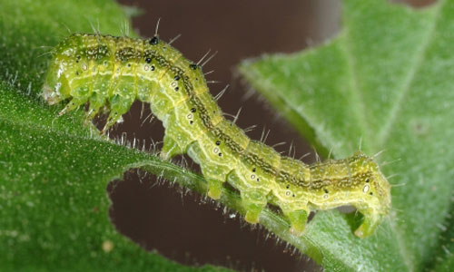
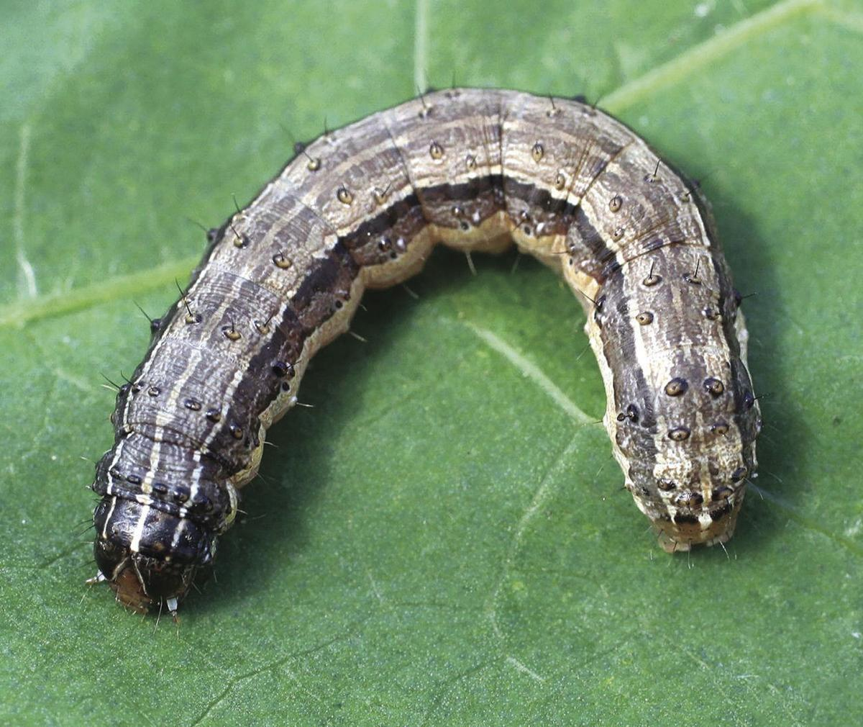
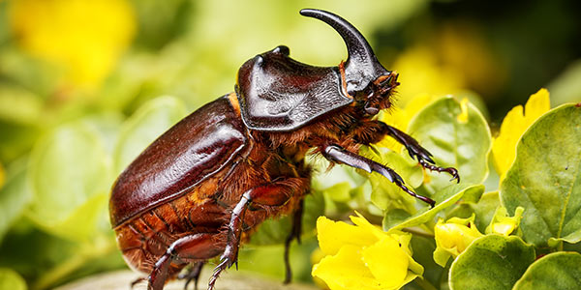
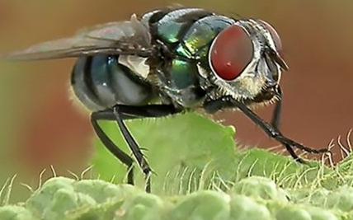
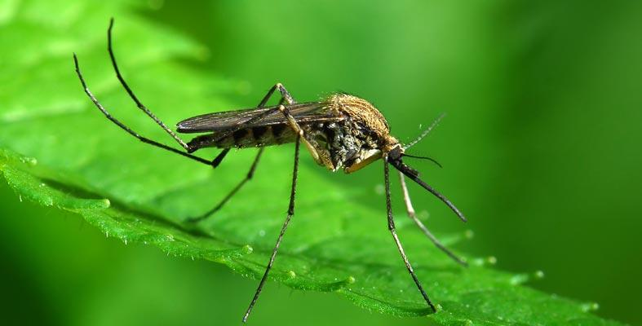
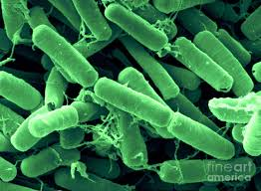
Bt toxin
Some strains of Bacillus thuringiensis produce toxic insecticidal protein crystals during a particular phase of their growth that kill certain insects such as
lepidopterans (tobacco budworm, armyworm),
coleopterans (beetles) and
dipterans (flies, mosquitoes).
How does Bt toxin kill insects?
Answer:
Ingestion of Bt toxin by insect
Bt toxin passes into gut of insect
Activation and solubilization of Bt toxin at alkaline pH of gut of insect
Bt toxin binds to the surface of midgut epithelial cells
Create of pores in the gut that cause cell swelling and lysis
Cause death of the insect.
Tobacco budworm
Armyworm
Beetles
Flies
Mosquitoe
Bacillus thuringiensis

Slide 10
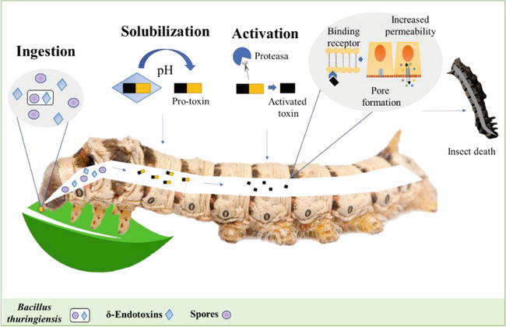
Figure Diagrammatic representation of Bt toxin killing insect

Slide 11
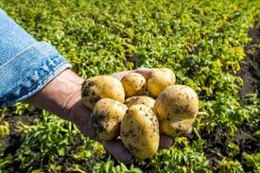
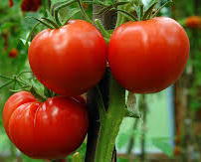
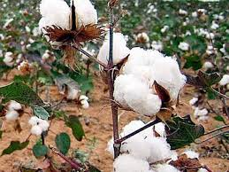
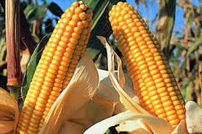
Bt plant
Bt toxin gene (cry gene) has been isolated from the Bacillus thuringiensis and incorporated into plants to produce Bt plants
Bt plants have incorporated and expressed Bt toxin gene.
Examples of Bt plants; Bt cotton, Bt corn, Bt rice, Bt tomato, Bt potato, Bt soyabean etc.
Bt plant are resistance to insects without the need for insecticides; in effect created a bio-pesticide.
The choice of genes depends upon the crop and the targeted pest.
Around 200 insect group specific, proteinaceous Bt toxins (coded by cry gene) were discovered. For example;
the proteinaceous toxin encoded by the genes cryIAc and cryIIAb control the cotton bollworms,
cryIAb controls corn borer.
Bacillus thuringiensis
Bt potato
Bt tomato
Bt cotton
Bt corn

Slide 12
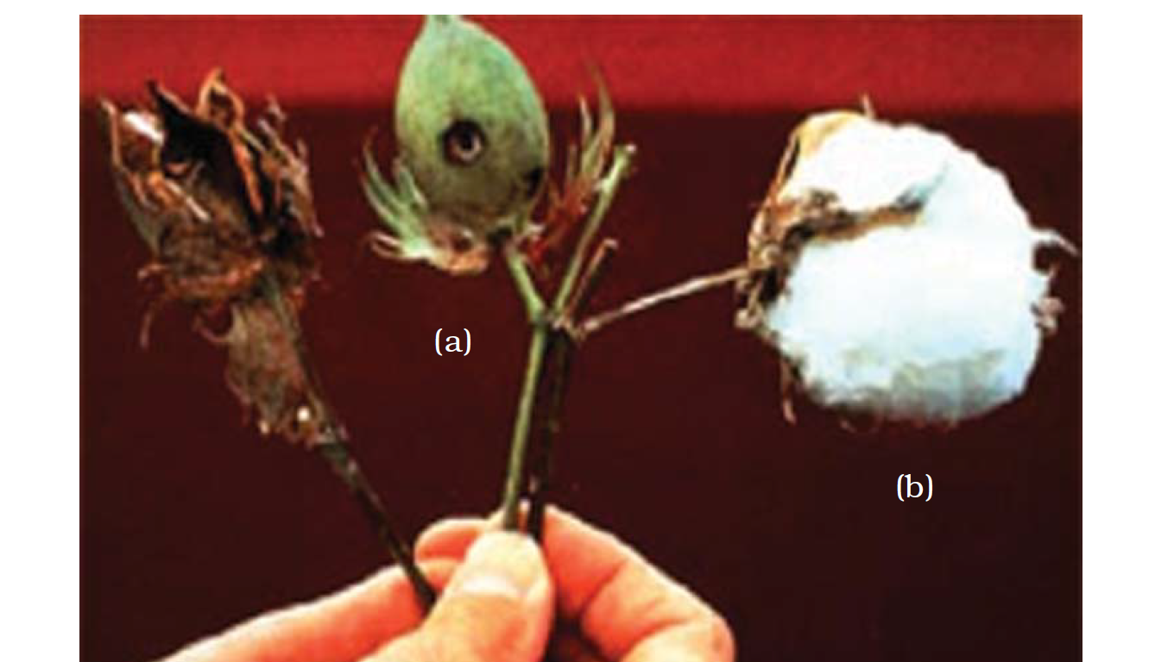
Bt Cotton
Bt Cotton possesses Bt toxin genes (isolated from Bacillus thuringiensis).
To control the cotton bollworms, Bt cottons are incorporated with cryIAc and cryIIAb.
Cotton boll destroyed by bollworms
A fully mature cotton boll
Figure Normal cotton boll
Healthy bollworm free Bt cotton

Slide 13
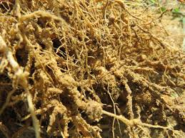
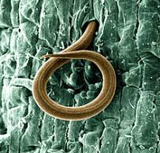
Pest Resistant GM tobacco Plants
Several nematodes parasitise plants and animals including human beings.
Meloidegyne incognitia (a nematode) infects the roots of tobacco plants and causes a great reduction in yield.
RNA interference (RNAi)/RNA silencing* was adopted to prevent infestation of roots of tobacco plants.
Meloidegyne incognitia of Tobacco
*A novel strategy of plant genetics

Slide 14
RNA interference (RNAi)/RNA silencing
RNAi takes place as a method of cellular defense in all eukaryotic organisms.
RNA interference is a method involving silencing of a specific mRNA (prevention translation of the mRNA) due to formation of complementary dsRNA molecule.
Prevention of translation of mRNA in nematode stops production of essential proteins (enzymes, hormones, etc) and Meloidegyne incognitia (Root knot nematode) dies.
The source of complementary dsRNA could be from
an infection by retroviruses or
mobile genetic elements/jumping genes (transposons) that replicate via an RNA intermediate.
3'
5'
A G C T A G C T A G C T G C T A G C A G C T
T C G A T C G A T C G A C G A T C G T C G A
DNA Helix
5'
3'
Transcription
U C G A U C G A U C G A C G A U C G U C G A
dd
A G C U A G C U A G C U G C U A G C A G C U
mRNA
Translation
No production of Protein
Protein
(Polymer of amino acids)
RNA interference (RNAi) is a mechanism of regulation or controlling gene expression by using Small interfering RNA

Slide 15
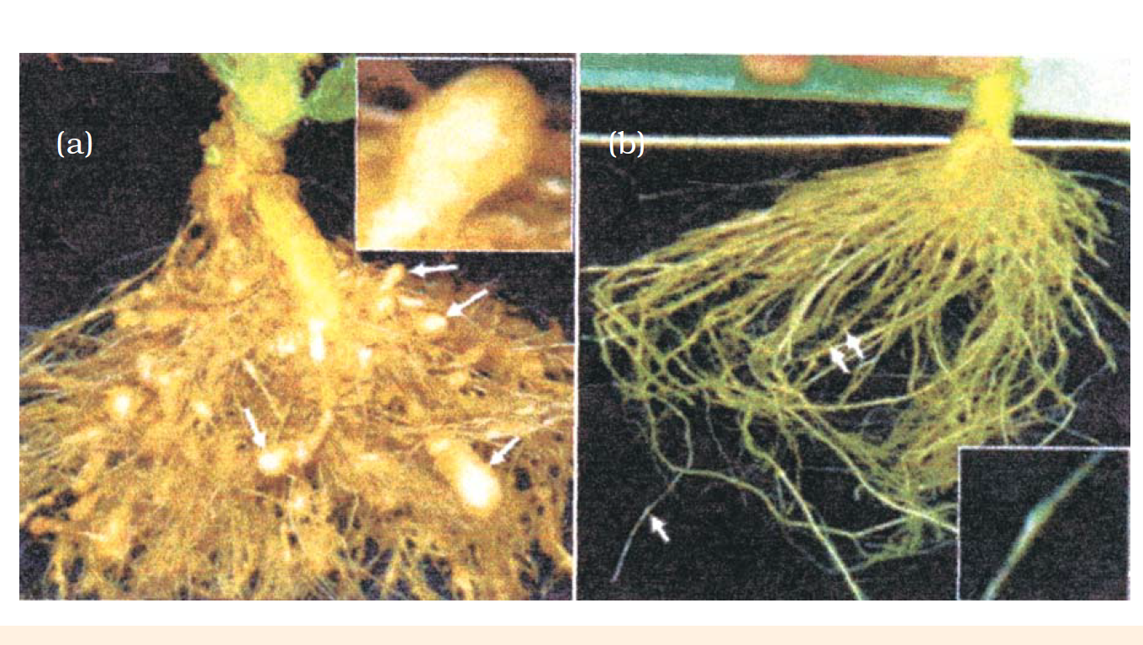
Figure Host plant generated dsRNA triggers protection against nematode infestation
Roots of a typical control plants
Transgenic plant roots 5 days after deliberate infection of nematode but protected through novel mechanism of RNAi

Slide 16
Manipulation of Pest Resistant GM tobacco Plants using RNA interference (RNAi)/RNA silencing
RNA induced Silencing Complex (RISC Complex) with unzipped SiRNA
dsRNA
Cleaves target mRNA
Agrobacterium vector
RISC Complex
Target mRNA
Meloidegyne incognitia
(Root knot nematode)
Dicer
Uptake of siRNA by Meloidegyne incognitia
Interaction of dicer with dsDNA
Small interfering RNA (siRNA )
Plant cell

Slide 17
RNA interference (RNAi) and pest Resistant GM Plant
Using Agrobacterium vectors, nematode-specific genes were introduced into the host plant.
The introduced DNA produce both sense and anti-sense RNA in the host cells.
Both sense and anti-sense RNA being complementary to each other form a double stranded (dsRNA) that initiated RNAi and thus, silenced the specific mRNA of the nematode.
The consequence was that the parasite could not survive in a transgenic host expressing specific interfering RNA.
The transgenic plant therefore got itself protected from the parasite

Slide 18
Biotechnological Applications In Medicine
The recombinant DNA (rDNA) technological processes have made immense impact in the area of healthcare by enabling mass production of safe and more effective therapeutic drugs.
The recombinant therapeutics* do not induce unwanted immunological responses as is common in case of similar products isolated from non-human sources.
At present, about 30 recombinant therapeutics* have been approved for human use all over the world.
In India, 12 of recombinant therapeutics are presently being marketed.
*medicine or therapy that cures disease or relieves pain

Slide 19
Fields of application of Biotechnology
Agriculture
Medicine
Genetically Modified Animals (GMA)
Or
Transgenic animals
Genetically modified Crops
Example; Bt plants (Bt cotton) [Bt toxin encoded by cry gene]
Recombinant therapeutics (Insulin)
rDNA vaccines
(Hepatitis B vaccine produced by using yeast)
Molecular Diagnostic techniques (PCR, ELISA, Autoradiography)
Gene therapy for hereditary diseases
GM mice (95%), GM Cow, GM Sheep, GM fish, etc
Uses of GMA
To study
Physiology and development
Diseases
Toxicity and chemical safety of drugs
Vaccine safety
To produce biological products
Alpha 1 antitrypsin (to treat emphysema)
Alpha lactalbumin by Rosie (cow) [1997] in milk -2.4 g/L]

Slide 20
Insulin as recombinant therapeutics
Management of adult-onset diabetes is possible by taking insulin at regular time intervals.
Earlier, insulin was extracted from pancreas of slaughtered cattle and pigs which caused some patients to develop allergy or other types of reactions to the foreign protein.
These days, large scale production of insulin is achieved by bacteria using rDNA technology.
Notes:
What would a diabetic patient do if enough human-insulin was not available? If you discuss this, you would soon realise that one would have to isolate and use insulin from other animals. Would the insulin isolated from other animals be just as effective as that secreted by the human body itself and would it not elicit an immune response in the human body?

Slide 21
Structure of Insulin
Insulin consists of two short polypeptide chains: chain A and chain B, that are linked together by disulphide bridges.
In mammals, including humans, insulin is synthesised as a prohormone/proinsulin which contains an extra stretch called the C peptide.
Proinsulin needs to be processed before it becomes a fully mature and functional hormone
C peptide
A peptide
I
S
I
S
I
A peptide
I
S
I
S
I
I
S
I
S
I
I I
S---S
B peptide
I
S
I
S
I
I I
S---S
B peptide
Mature insulin
Proinsulin
Notes:
What would a diabetic patient do if enough human-insulin was not available? If you discuss this, you would soon realise that one would have to isolate and use insulin from other animals. Would the insulin isolated from other animals be just as effective as that secreted by the human body itself and would it not elicit an immune response in the human body?

Slide 22
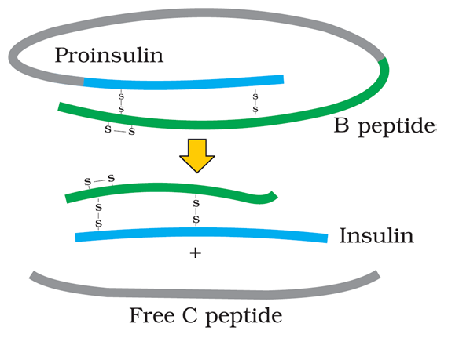
Figure Maturation of pro-insulin into insulin after removal of C peptide
C peptide
A peptide
C peptide is removed during maturation into insulin.
C peptide is not present in the mature insulin

Slide 23


Genetically Engineered Insulin (Eli Lilly an American company (1983) produced genetically engineered insulin)
Gene encoding A peptide
Gene encoding B peptide
A peptide
B peptide
I
S
I
S
I
I
S
I
S
I
I I
S---S
Insulin
Notes:
The main challenge for production of insulin using rDNA techniques was getting insulin assembled into a mature form.

Slide 24
Genetically Engineered Insulin
In 1983, Eli Lilly an American company produced genetically engineered insulin as follow;
Prepared two DNA sequences encoding A and B chains of human insulin
Introduced these DNA in plasmids of E. coli to produce insulin chains.
Chains A and B were produced separately by E. coli and extracted
Two chains were combined by creating disulfide bonds
Formed human insulin
Notes:
The main challenge for production of insulin using rDNA techniques was getting insulin assembled into a mature form.

Slide 25
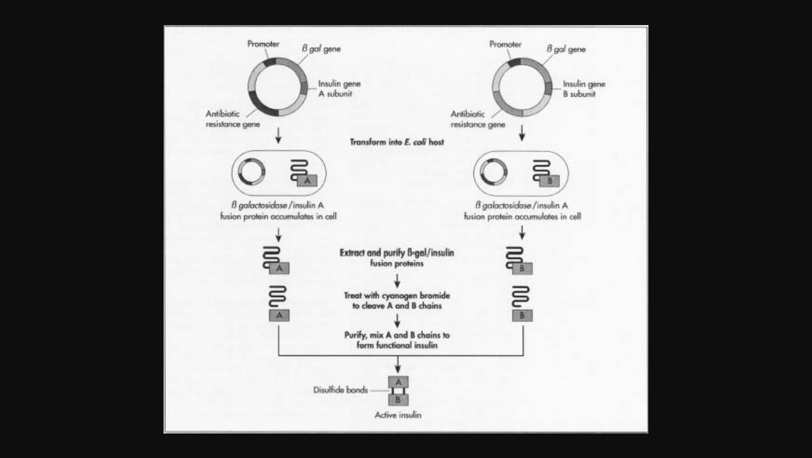
Genetically Engineered Insulin
Notes:
The main challenge for production of insulin using rDNA techniques was getting insulin assembled into a mature form.

Slide 26
Gene Therapy
Gene therapy helps in correction/treatment of a gene defect* that has been diagnosed in a child/embryo.
In gene therapy, normal genes are inserted/delivered into a person’s cells and tissues of individual or embryo to treat hereditary disease.
Delivered normal gene into the individual or embryo takes over the function of the non-functional gene.
*Non-functional gene leading to hereditary disease

Slide 27
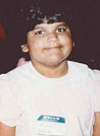

Gene Therapy
In 14 September 1990, the first clinical gene therapy was given to Ashanti De Silva at age of 4 year old with adenosine deaminase (ADA) deficiency.
The ADA deficiency is caused due to the deletion of the gene for adenosine deaminase.
Adenosine deaminase (ADA) enzyme is crucial for the immune system to function.
ADA deficiency can be treated in children by
bone marrow transplantation
enzyme replacement therapy in which functional ADA is given to the patient by injection.
Bone marrow transplantation and enzyme replacement therapy approaches are not completely curative.
1992
2018
Ashanti De Silva

Slide 28
Gene Therapy
Grown lymphocytes (from the blood of the patient) in a culture in laboratory (invitro)
A functional ADA cDNA is introduced into these lymphocytes using a retroviral vector
Functional lymphocytes are returned to the patient
Normal human ADA gene
Disabled retroviral vector
Disabled retrovirus with ADA gene
Retrovirus infects lymphocytes, transfers ADA gene into the cells
Genetically altered lymphocytes are reimplanted to produce ADA
Ashanti De Silva
T lymphocytes from Ashanti De Silva
The patient requires periodic infusion of such genetically engineered lymphocytes as the synthesised lymphocytes are not immortal
Lymphocytes are grown to ensure ADA gene is active

Slide 29
For permanent cure of ADA deficiency by gene Therapy….
Gene therapy could be a permanent cure if the gene isolate from marrow cells producing ADA is introduced into cells at early embryonic stages.

Slide 30
Molecular Diagnosis
For effective treatment of a disease, early diagnosis and understanding its pathophysiology is very important.
Presence of a pathogen (bacteria, viruses, etc.) is normally suspected only when the pathogen has produced a disease symptom. By this time the concentration of pathogen is already very high in the body.
Early detection of disease is not possible using conventional methods of diagnosis (serum and urine analysis, etc.)
Techniques that helps in early diagnosis or risk of diseases are;
Polymerase Chain Reaction (PCR)
Enzyme Linked Immuno-sorbent Assay (ELISA)
Autoradiography

Slide 31
PCR as molecular Diagnostic technique
PCR detect very low concentration of a bacteria or virus (at a time when the symptoms of the disease are not yet visible) by amplification of their nucleic acid
PCR is used to detect mutations in genes in suspected cancer patients.
PCR is a powerful technique to identify many genetic disorders.

Slide 32
Autoradiography as molecular Diagnostic technique
Autoradiography helps in diagnosis of genetic disorders due to mutation of gene.
Autoradiography involves making a radio labeled probe complimentary to normal DNA or RNA.
Process of diagnosis of genetic disorders due to mutation of gene by autoradiography
+ ³²P/ ³⁵S
A single stranded DNA (or RNA) is tagged with a radioactive molecule (probe)
The radiolabeled probe sDNA or sRNA is allowed to hybridise to its complementary DNA in a clone of cells
Detected using autoradiography
Probe (= sDNA or sRNA + radioactive substance)
Clones of cells
RESULT: The clone having the mutated gene will not appear on the photographic (X-ray film) because the probe will not have complementarity with the mutated gene.
Notes:
Making a radio labelled probe complimentary to normal DNA or RNA

Slide 33
Autoradiography as molecular Diagnostic technique
Autoradiography helps in diagnosis of genetic disorders due to mutation of gene.
Autoradiography involves making a radio labeled probe complimentary to normal DNA or RNA.
Process of diagnosis of genetic disorders due to mutation of gene by autoradiography
A single stranded DNA or RNA is tagged with a radioactive molecule (probe)
The radiolabelled probe sDNA or sRNA is allowed to hybridise to its complementary DNA in a clone of cells
Detected using autoradiography.
RESULT: The clone having the mutated gene will not appear on the photographic film, because the probe will not have complimentarity with the mutated gene.
Notes:
Making a radio labelled probe complimentary to normal DNA or RNA

Slide 34
ELISA as molecular Diagnostic technique
Enzyme Linked Immuno-sorbent Assay (ELISA) is based on the principle of antigen-antibody interaction.
Infection by pathogen can be detected
by the presence of antigens (proteins, glycoproteins, etc.) or
by detecting the antibodies synthesised against the pathogen.

Slide 35
TRANSGENIC ANIMALS
Transgenic animals are those animals that have had their DNA manipulated to possess and express an extra (foreign) gene.
Over 95% of all existing transgenic animals are mice.
Other transgenic animals are; transgenic rats, rabbits, pigs, sheep, cows and fish.
Need to produce/benefits/Use of transgenic animals are;
To study normal physiology and development
To study of disease
To produce biological products
To test vaccine safety
For chemical safety testing

Slide 36
Transgenic animals to study normal physiology and development
Transgenic animals can be designed to allow the study
how genes are regulated, and
how genes affect the normal functions of the body and its development e.g., study of complex factors involved in growth such as insulin-like growth factor.

Slide 37
Transgenic Animals for Study of disease
Many transgenic animals are designed to increase our understanding of how genes contribute to the development of disease.
Transgenic Animals are made to serve as models for human diseases so that investigation of new treatments for diseases is made possible. For example; transgenic models used to study cancer, cystic fibrosis, rheumatoid arthritis and Alzheimer’s.

Slide 38
Transgenic Animals for Biological products
Medicines required to treat certain human diseases can contain biological products produced by transgenic animals.
Useful biological products produced by transgenic animals can be created by the introduction of the portion of DNA (or genes) which codes for a particular product. For example: human protein (α-1-antitrypsin) used to treat emphysema.
Similar attempts are being made for treatment of phenylketonuria (PKU) and cystic fibrosis.
In 1997, Rosie the first transgenic cow produced human protein-enriched milk (2.4 grams per litre).
The Rosie milk contained the human alpha-lactalbumin and was nutritionally a more balanced product for human babies than natural cow-milk.

Slide 39
Transgenic Animals to study vaccine safety
Transgenic mice are
used in testing the safety of vaccines before they are used on humans.
used to test the safety of the polio vaccine.
If successful and found to be reliable, Transgenic mice could replace the use of monkeys to test the safety of batches of the vaccine.

Slide 40
Transgenic animals to study chemical safety testing
Chemical safety testing known as toxicity/safety testing.
The procedure is the same as that used for testing toxicity of drugs.
Transgenic animals are made that carry genes which make them more sensitive to toxic substances than non-transgenic animals.
Transgenic animals are then exposed to the toxic substances and the effects studied.
Toxicity testing in such animals will allow us to obtain results in less time.

Slide 41
ETHICAL ISSUES

Slide 42
Terminologies related to ethical issues
Ethics:
Set of principles governing morality and acceptable conduct
Intellectual property
Intellectual property refers to creations of the mind (inventions; literary and artistic works; and symbols, names and images used in commerce)
Patents:
An official document/licence granting sole rights or privilege to an inventor for an invention and exclude others from making, using, or selling an invention.
Biopiracy
Biopiracy refer to the use of bio-resources by multinational companies and other organisations without proper authorisation from the countries and people concerned without compensatory payment.

Slide 43
Read the section 12.4 ETHICAL ISSUES and try to answer the following questions
Name the organisations set up by Indian Government which makes decisions regarding the validity of GM research and the safety of introducing GM-organisms for public services.
Answer: Genetic Engineering Approval Committee (GEAC)
Name the US patent office.
US Patent and Trademark Office
Name some products which were traditionally used in India and are granted patents for non Indian organisations.
Answer:
Basmati rice (having unique aroma and flavour)
Turmeric,
Neem

Slide 44

http://www.ipindia.nic.in

Slide 45
Chapter ends here.....

Slide 46
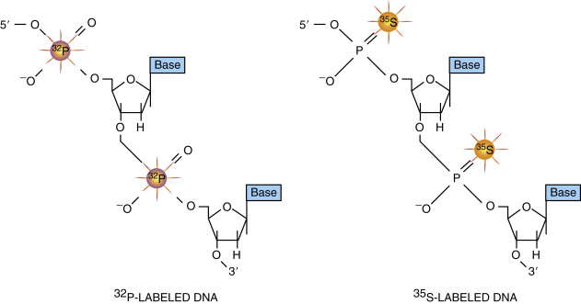

Slide 47
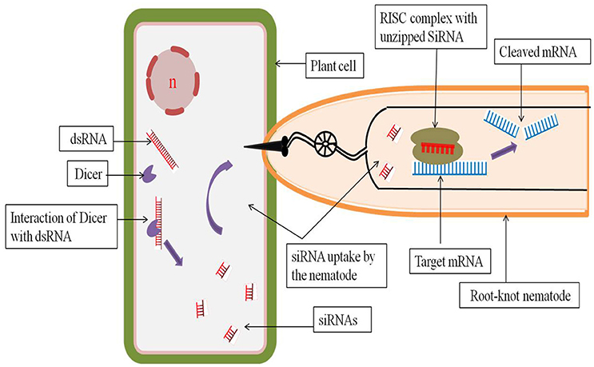
RNA interference (RNAi) and pest Resistant GM Plant

Slide 48
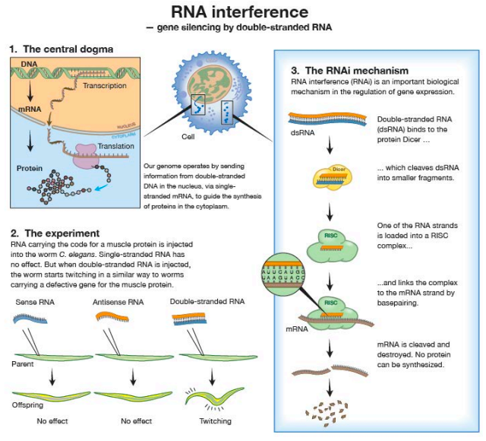

Slide 49
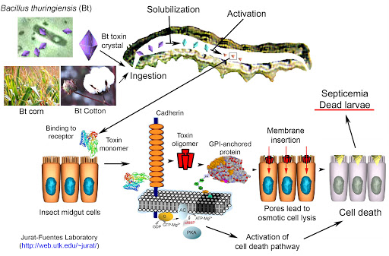
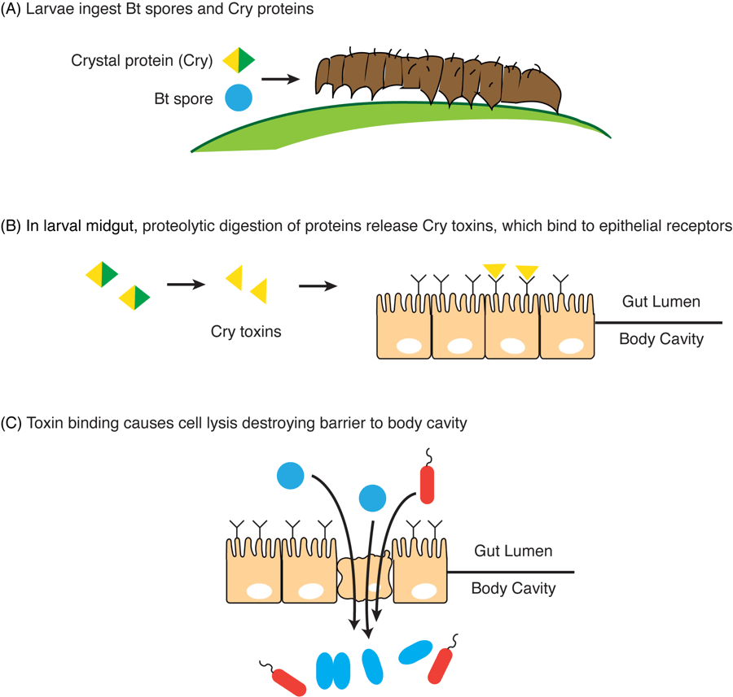
Bt Cotton
Specific Bt toxin genes were isolated from Bacillus thuringiensis and incorporated into cotton to get Bt cotton.
The choice of genes depends upon the crop and the targeted pest, as most Bt toxins are insect-group specific and there are around 200 Bt toxins.
The Bt toxin is coded by a gene named cry.
Number of proteins are coded by cry gene, for example;
the proteins encoded by the genes cryIAc and cryIIAb control the cotton bollworms,
cryIAb controls corn borer.

Slide 50
What are the significance of genetic modification?
Genetic modification has:
made crops more tolerant to abiotic stresses (cold, drought, salt, heat).
reduced reliance on chemical pesticides (pest-resistant crops).
helped to reduce post harvest losses.
increased efficiency of mineral usage by plants (this prevents early exhaustion of fertility of soil).
enhanced nutritional value of food, e.g., Vitamin ‘A’ enriched rice.
GM has been used to create tailor-made* plants to supply alternative resources to industries, in the form of starches, fuels and pharmaceuticals.

Slide 51
ETHICAL ISSUES
The manipulation of living organisms by the human race cannot go on any further, without regulation. Some ethical standards are required to evaluate the morality of all human activities that might help or harm living organisms.
Going beyond the morality of such issues, the biological significance of such things is also important. Genetic modification of organisms can have unpredicatable results when such organisms are introduced into the ecosystem.
Therefore, the Indian Government has set up organisations such as GEAC (Genetic Engineering Approval Committee), which will make decisions regarding the validity of GM research and the safety of introducing GM-organisms for public services.
The modification/usage of living organisms for public services (as food and medicine sources, for example) has also created problems with patents granted for the same.

Slide 52
ETHICAL ISSUES
There is growing public anger that certain companies are being granted patents for products and technologies that make use of the genetic materials, plants and other biological resources that have long been identified, developed and used by farmers and indigenous people of a specific region/country.
Rice is an important food grain, the presence of which goes back thousands of years in Asia’s agricultural history. There are an estimated 200,000 varieties of rice in India alone. The diversity of rice in India is one of the richest in the world.
Basmati rice is distinct for its unique aroma and flavour and 27 documented varieties of Basmati are grown in India. There is reference to Basmati in ancient texts, folklore and poetry, as it has been grown for centuries. In 1997, an American company got patent rights on Basmati rice through the US Patent and Trademark Office. This allowed the company to sell a ‘new’ variety of Basmati, in the US and abroad. This ‘new’ variety of Basmati had actually been derived from Indian farmer’s varieties. Indian Basmati was crossed with semi-dwarf varieties and claimed as an invention or a novelty. The patent extends to functional equivalents, implying that other people selling Basmati rice could be restricted by the patent.
Several attempts have also been made to patent uses, products and processes based on Indian traditional herbal medicines, e.g., turmeric, neem. If we are not vigilant and we do not immediately counter these patent applications, other countries/individuals may encash on our rich legacy and we may not be able to do anything about it.

Slide 53
ETHICAL ISSUES
Biopiracy refer to the use of bio-resources by multinational companies and other organisations without proper authorisation from the countries and people concerned without compensatory payment.
Most of the industrialised nations are rich financially but poor in biodiversity and traditional knowledge. In contrast the developing and the underdeveloped world is rich in biodiversity and traditional knowledge related to bio-resources. Traditional knowledge related to bio-resources can be exploited to develop modern applications and can also be used to save time, effort and expenditure during their commercialisation.
There has been growing realisation of the injustice, inadequate compensation and benefit sharing between developed and developing countries. Therefore, some nations are developing laws to prevent such unauthorised exploitation of their bio-resources and traditional knowledge. The Indian Parliament has recently cleared the second amendment of the Indian Patents Bill, that takes such issues into consideration, including patent terms emergency provisions and research and development initiative.

